Slide 1
Airborne Fire Detection with Machine Learning
MASTER Hyperspectral Sensor | FireSense 2023 Campaign
Multi-Layer Perceptron & Tabular Prior-Fitted Networks (TabPFN)
Kaibab Plateau, Arizona | October 18-20, 2023

Slide 2
Problem Statement
Detect active fire and burn scars from airborne hyperspectral imagery during prescribed burns
Traditional threshold-based detectors suffer from false positives (sun glint, hot bare soil) and false negatives (smoldering edges)
Need a robust, automated method that generalizes across day/night conditions and multiple flight passes
Goal: reduce error rate (FP + FN) / P while maintaining near-perfect recall on true fire pixels
Key Challenges
Extreme class imbalance: ~1.7% of pixels are fire
Day/night radiometric differences
SWIR saturation near flame front
Pre-burn flight has zero true fire — all detections are FP

Slide 3
The MASTER Instrument
MODIS/ASTER Airborne Simulator — 50 Spectral Channels
Airborne whisk-broom scanner on NASA ER-2 / Twin Otter
50 channels spanning 0.4 - 13 μm (VNIR, SWIR, MWIR, TIR)
Spatial resolution: ~5-50 m depending on altitude
High spectral resolution enables physics-based fire detection
Key Channels for Fire Detection
Band | Channel | Wavelength | Use
T4 | Ch 31 | 3.903 μm | Fire detection (MWIR peak)
T11 | Ch 48 | 11.327 μm | Background temperature
SWIR | Ch 22 | 2.162 μm | Solar reflection / false alarm
Red | Ch 5 | 0.654 μm | NDVI (vegetation health)
NIR | Ch 9 | 0.866 μm | NDVI (vegetation health)

Slide 4
FireSense 2023 — Dataset & Flights
Prescribed burn on the Kaibab Plateau, Arizona
Flight | Date | Files | Condition | Fire Present
24-801-03 | Oct 18 | 14 | Pre-burn (daytime) | No
24-801-04 | Oct 19 | 22 | Active fire (night) | Yes
24-801-05 | Oct 19 | 12 | Overnight (night) | Yes
24-801-06 | Oct 20 | 13 | Smoldering (day) | Yes
61 HDF files total across 4 flights, covering pre-burn baseline through post-burn smoldering
Each HDF file = one scan sweep with 50 spectral channels + lat/lon geolocation

Slide 5
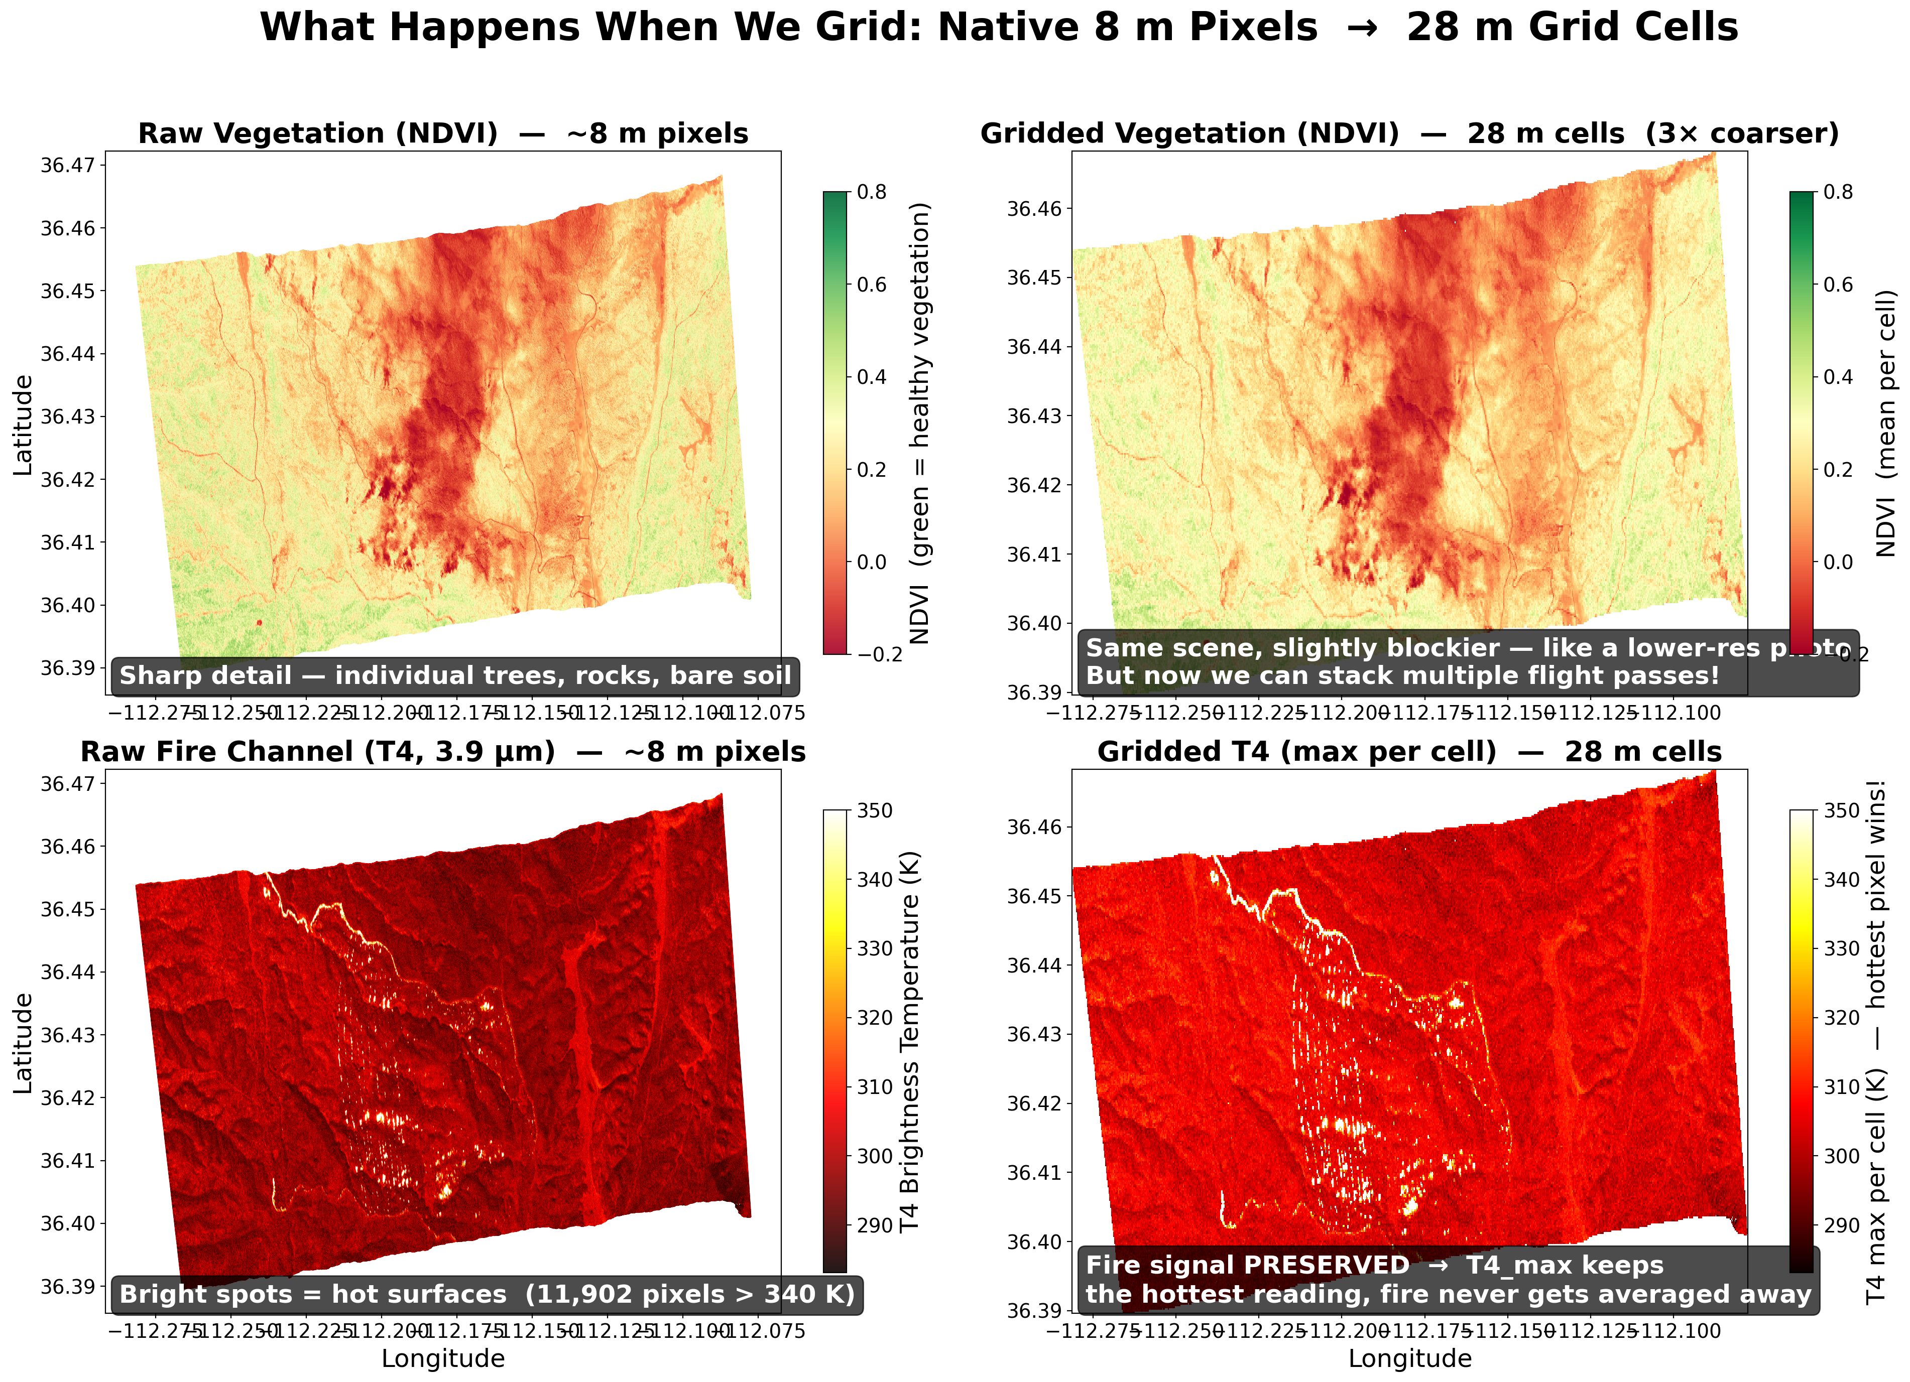
Grid Resolution & Spatial Resampling
Why we grid: from irregular scan pixels to a regular mosaic
Native MASTER pixel spacing: ~8 m (whisk-broom scan geometry)
Grid resolution: GRID_RES = 0.00025° ≈ 28 m at 36°N
This is a ~3× downsampling from native resolution
Each sweep has irregular pixel layout; gridding enables multi-pass stacking
Why Grid Resolution Matters
Enables multi-pass consistency filter (same grid cell, multiple sweeps)
Aggregates ~3 raw pixels per cell → noise reduction
Running accumulators: T4_max, dT_max, obs_count per cell
Trades spatial resolution for temporal depth and compute speed

Slide 6
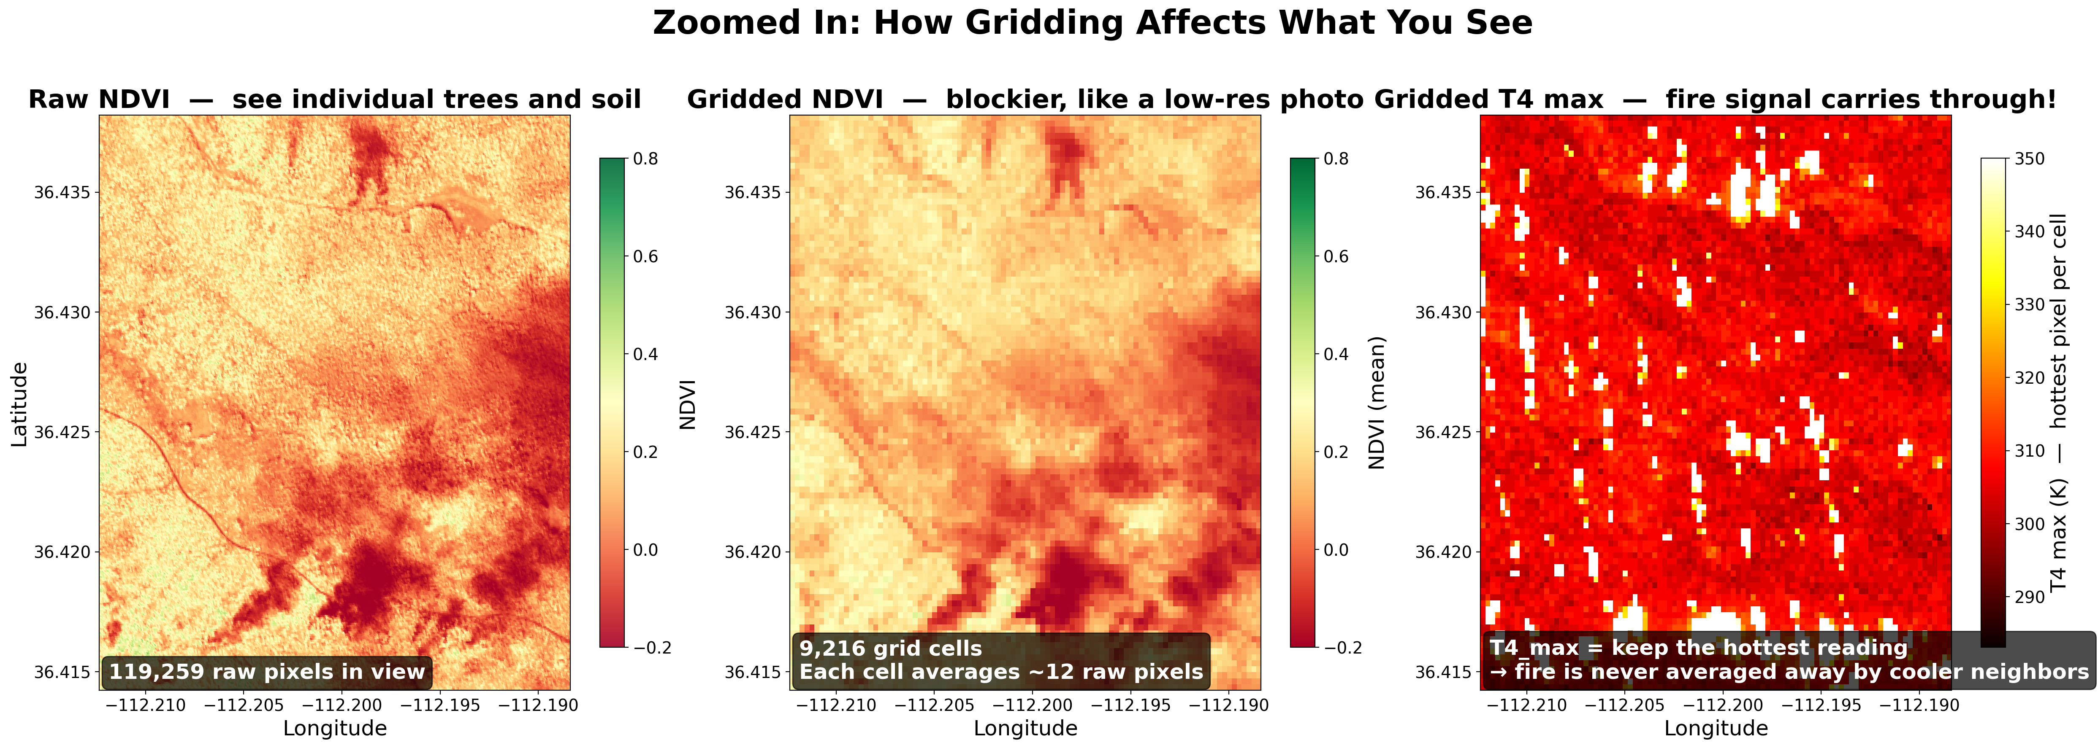
Grid Resolution — Pixel-to-Cell Mapping
How multiple raw pixels map into a single grid cell
Row index: (lat_max − lat) / GRID_RES | Col index: (lon − lon_min) / GRID_RES
Multiple raw pixels landing in the same cell: last observation writes T4/T11, but running accumulators track max, sum, and count across all sweeps
Single sweep: ~1 pixel/cell | After 40 sweeps (Flight 04): up to 40 observations/cell

Slide 7
Fire Detection — Physics
Planck's Law & Brightness Temperature
Fire at ~800 K is 23,000× brighter than 300 K background at 3.9 μm (T4)
At 11.3 μm (T11), fire is only ~6× brighter — ΔT = T4 - T11 is key discriminator
Planck radiance: B(λ,T) = (2hc²/λ⁵) / (exp(hc/λkT) - 1)
Brightness temperature inverts Planck equation to get equivalent blackbody T
Threshold Detection Rules
Simple: T4 > 325 K AND ΔT > 10 K
Contextual: pixel T4 > mean + 3σ of 61×61 neighborhood
SWIR rejection: if radiance in 2.2 μm band is high, likely solar reflection not fire
Multi-pass consistency: require fire in ≥2 passes (52% FP reduction on pre-burn flight)

Slide 8
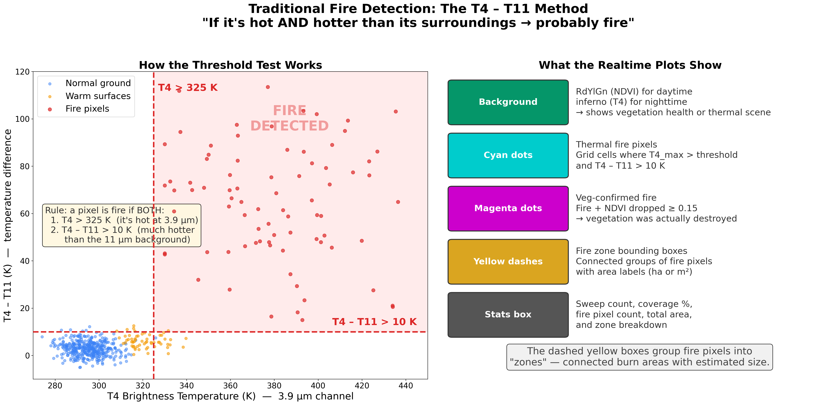

Slide 9
Vegetation-Loss Fire Confirmation
NDVI tracking for burn scar verification
NDVI = (NIR - Red) / (NIR + Red) — measures vegetation health
Baseline NDVI captured from first valid daytime pass (write-once per pixel)
Fire confirmed when NDVI drops ≥0.15 from baseline at a thermal-fire pixel
Nighttime fire with existing daytime baseline directly confirms vegetation loss
Confirmed pixels override best-illuminated compositing rule — ensures burn scars remain visible
Why This Matters
Reduces false positives from transient heat sources
Physical confirmation: fire should destroy vegetation
Provides temporal evidence — links thermal anomaly to actual burn
VEG_LOSS_THRESHOLD = 0.15 (configurable in lib/constants.py)

Slide 10
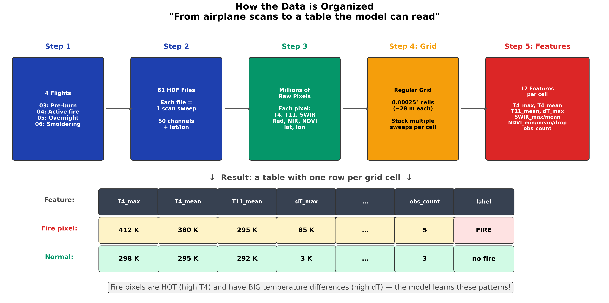

Slide 11
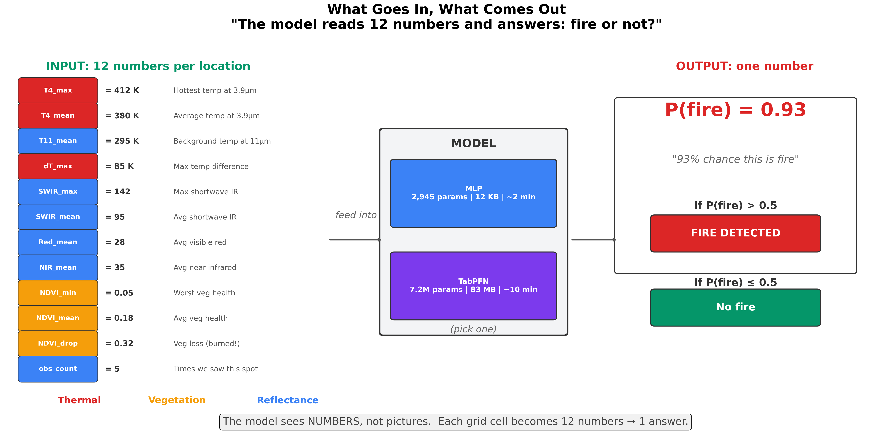

Slide 12
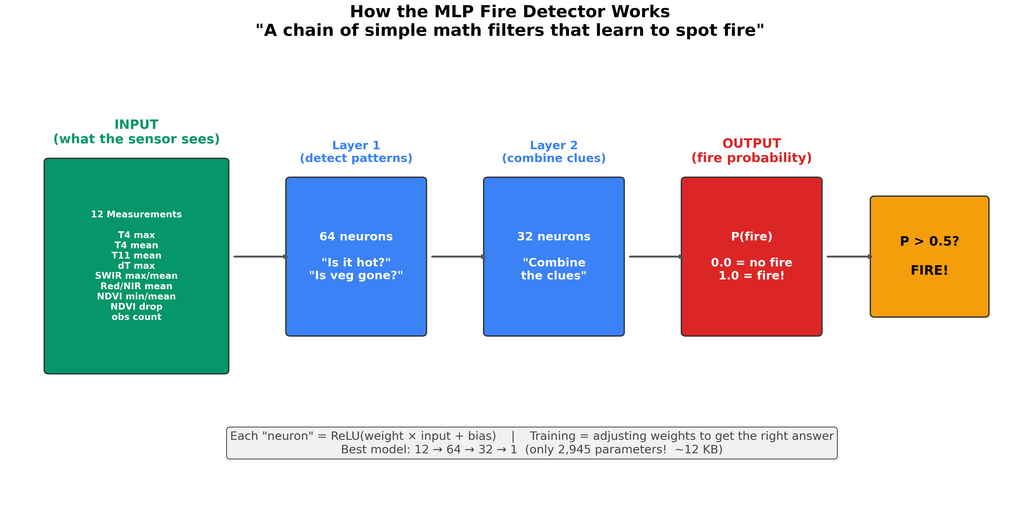

Slide 13
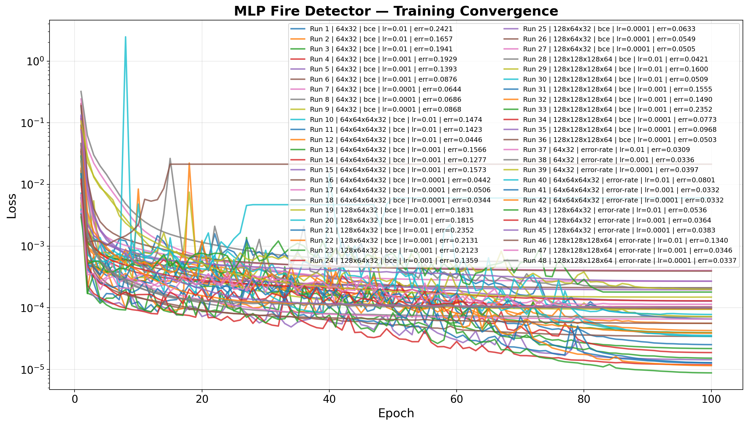
MLP Results — Best Model
Run 37: SoftErrorRateLoss | [64, 32] | lr=0.01
Metric | Value
Error Rate | 0.0309 (= (FP + FN) / P)
True Positives (TP) | 9,009
False Positives (FP) | 221
False Negatives (FN) | 59
True Negatives (TN) | 519,558
Precision | 0.9761
Recall | 0.9935
Architecture | 12 → 64 → 32 → 1

Slide 14
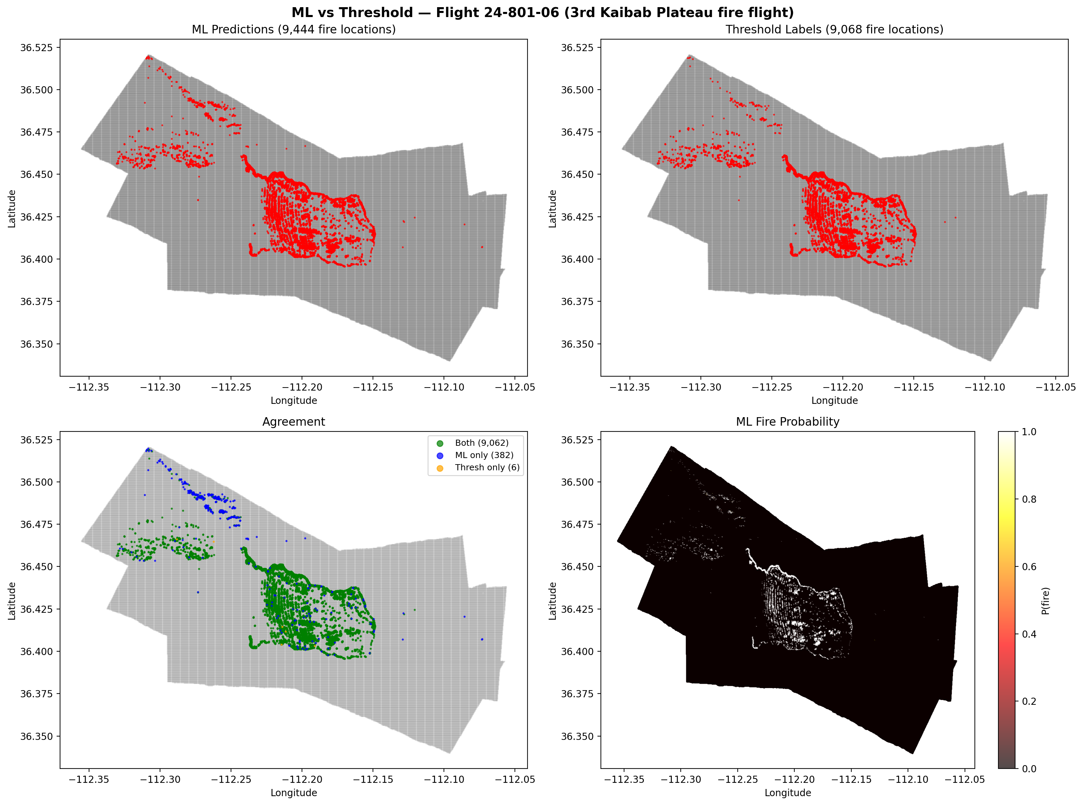
MLP — Spatial Prediction Maps
Flight 24-801-06 (daytime smoldering)

Slide 15
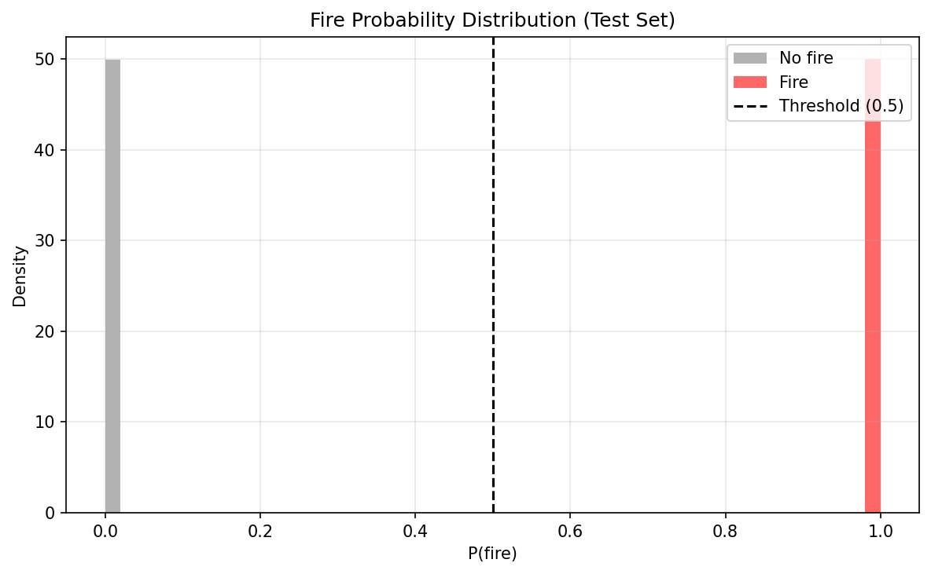
MLP — Probability Calibration
P(fire) distribution for fire vs non-fire pixels

Slide 16
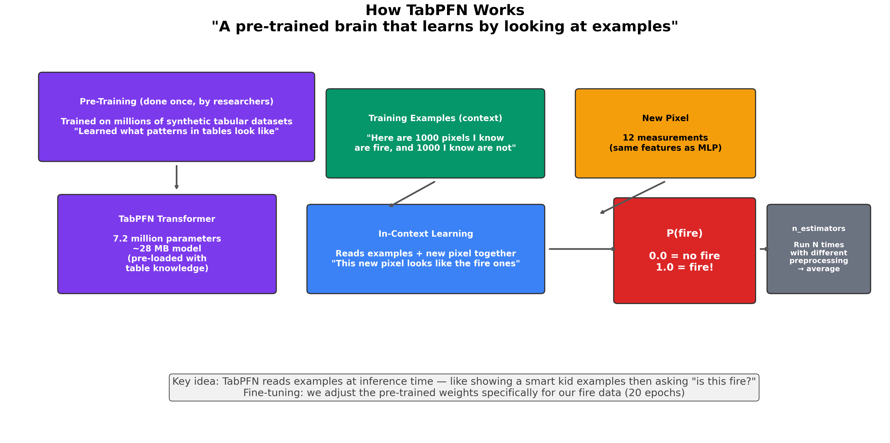

Slide 17
TabPFN Results
Classification & Regression — pending training completion
TabPFN training has not been completed yet. Run train-all-models.sh to generate results and convergence plots.

Slide 18
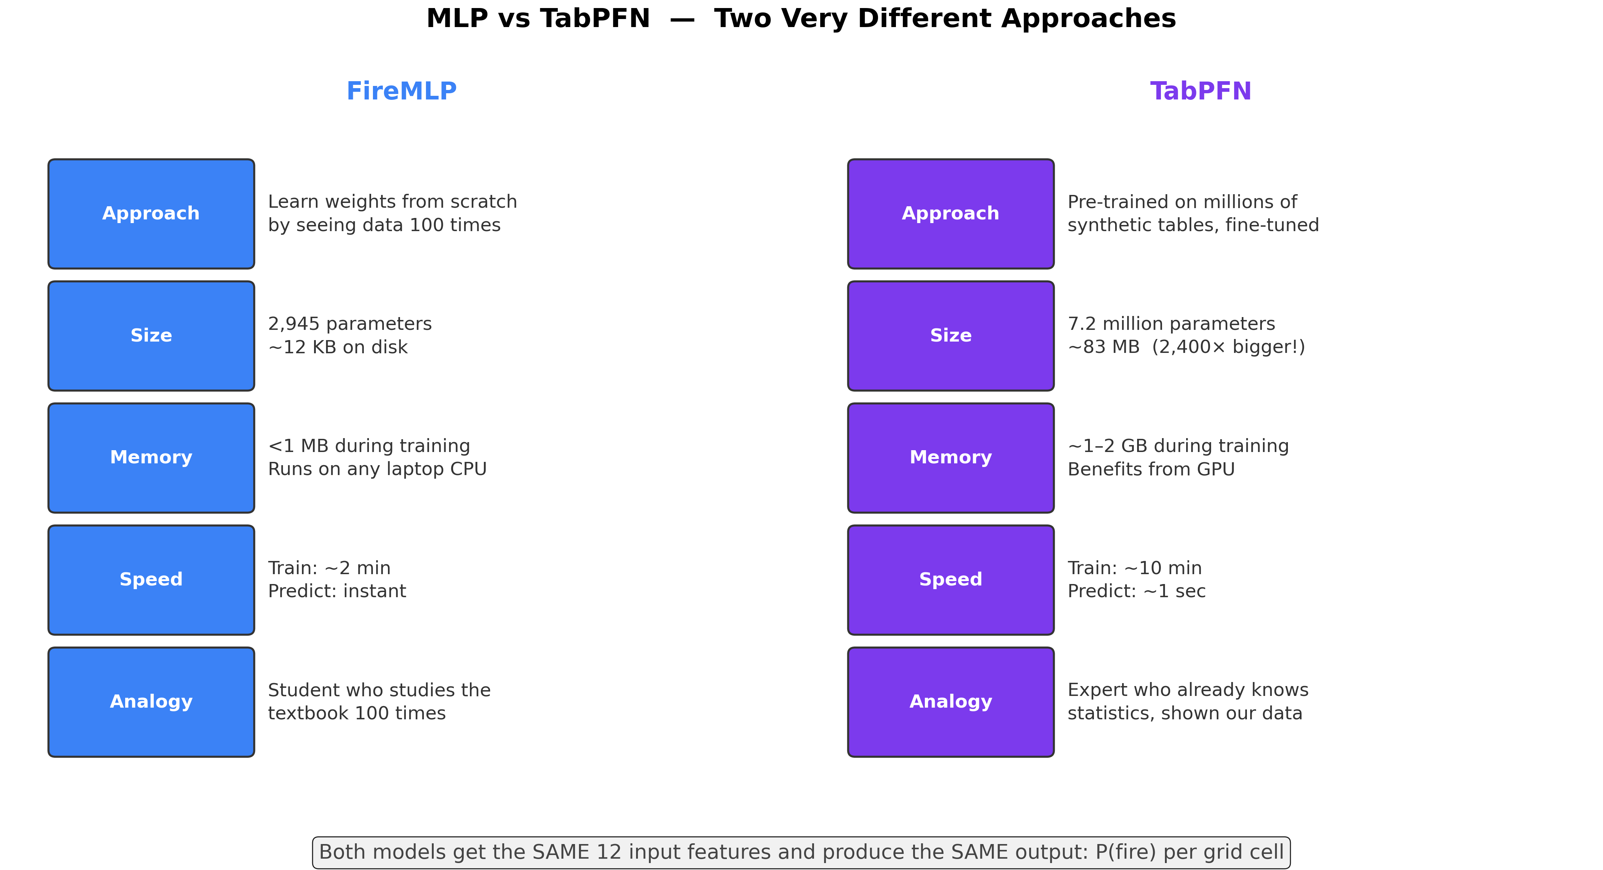

Slide 19
Processing Pipeline
From raw HDF to fire detection
1. Ingest
Read MASTER L1B HDF files (50 channels)
2. Calibrate
Planck inversion → Brightness Temperature
3. Grid
Mosaic sweeps onto lat/lon grid
4. Features
Compute 12 aggregate features
5. Detect
ML inference or threshold rules
6. Validate
Multi-pass + Veg-loss confirmation
→
→
→
→
→
Real-time simulation mode: process sweeps sequentially with live matplotlib animation (realtime_fire.py)
All shared logic in lib/ package — scripts are thin orchestration wrappers

Slide 20
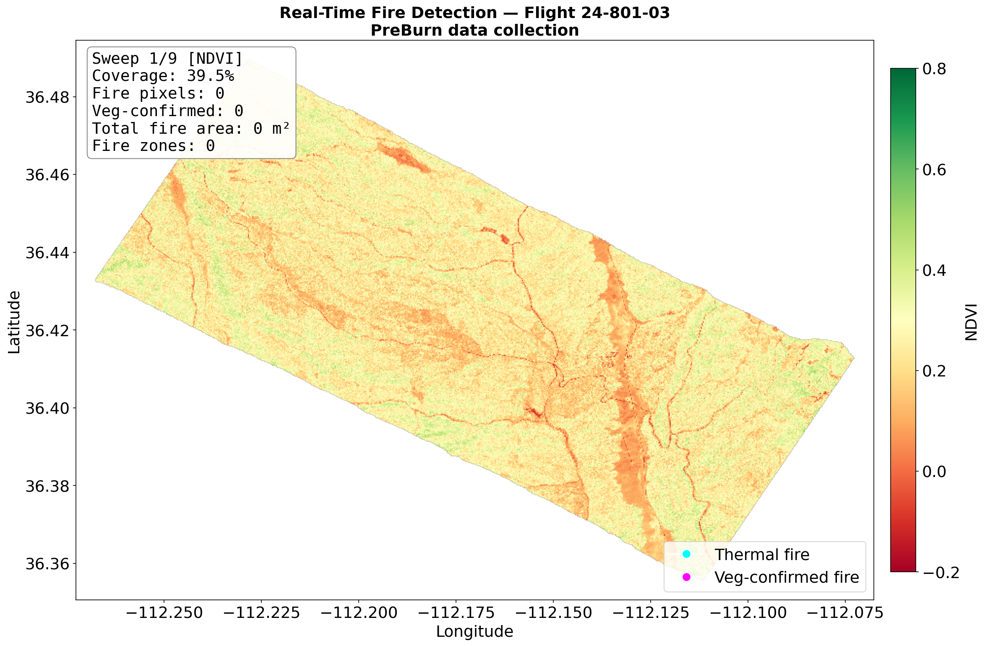
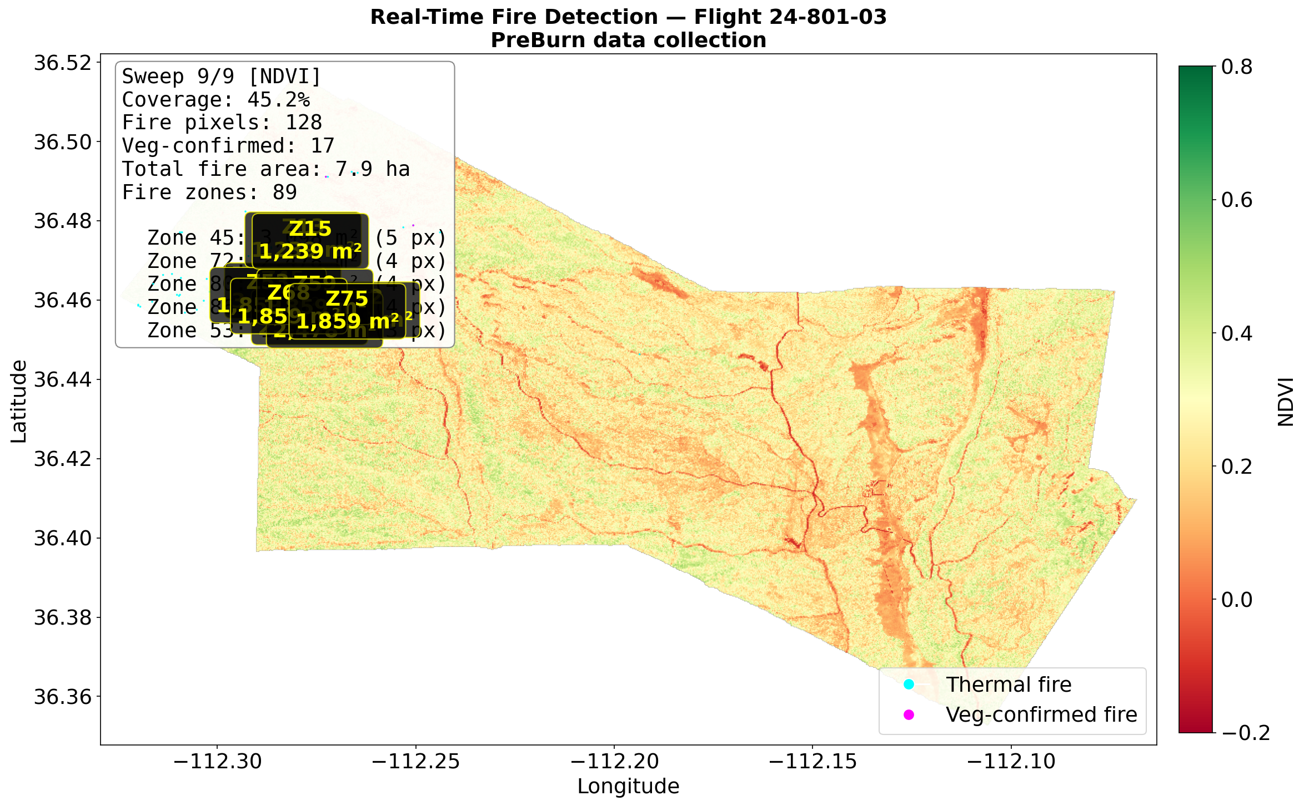
Real-Time Simulation — Pre-Burn Baseline
Flight 24-801-03: Daytime, no fire (9 sweeps)
Sweep 1/9 — First sweep (NDVI baseline)
Sweep 9/9 — Complete coverage, 0 fire pixels
Pre-burn flight establishes NDVI vegetation baseline and confirms zero fire detections
GIF animation: plots/gifs/ml_2480103_pre-burn.gif

Slide 21
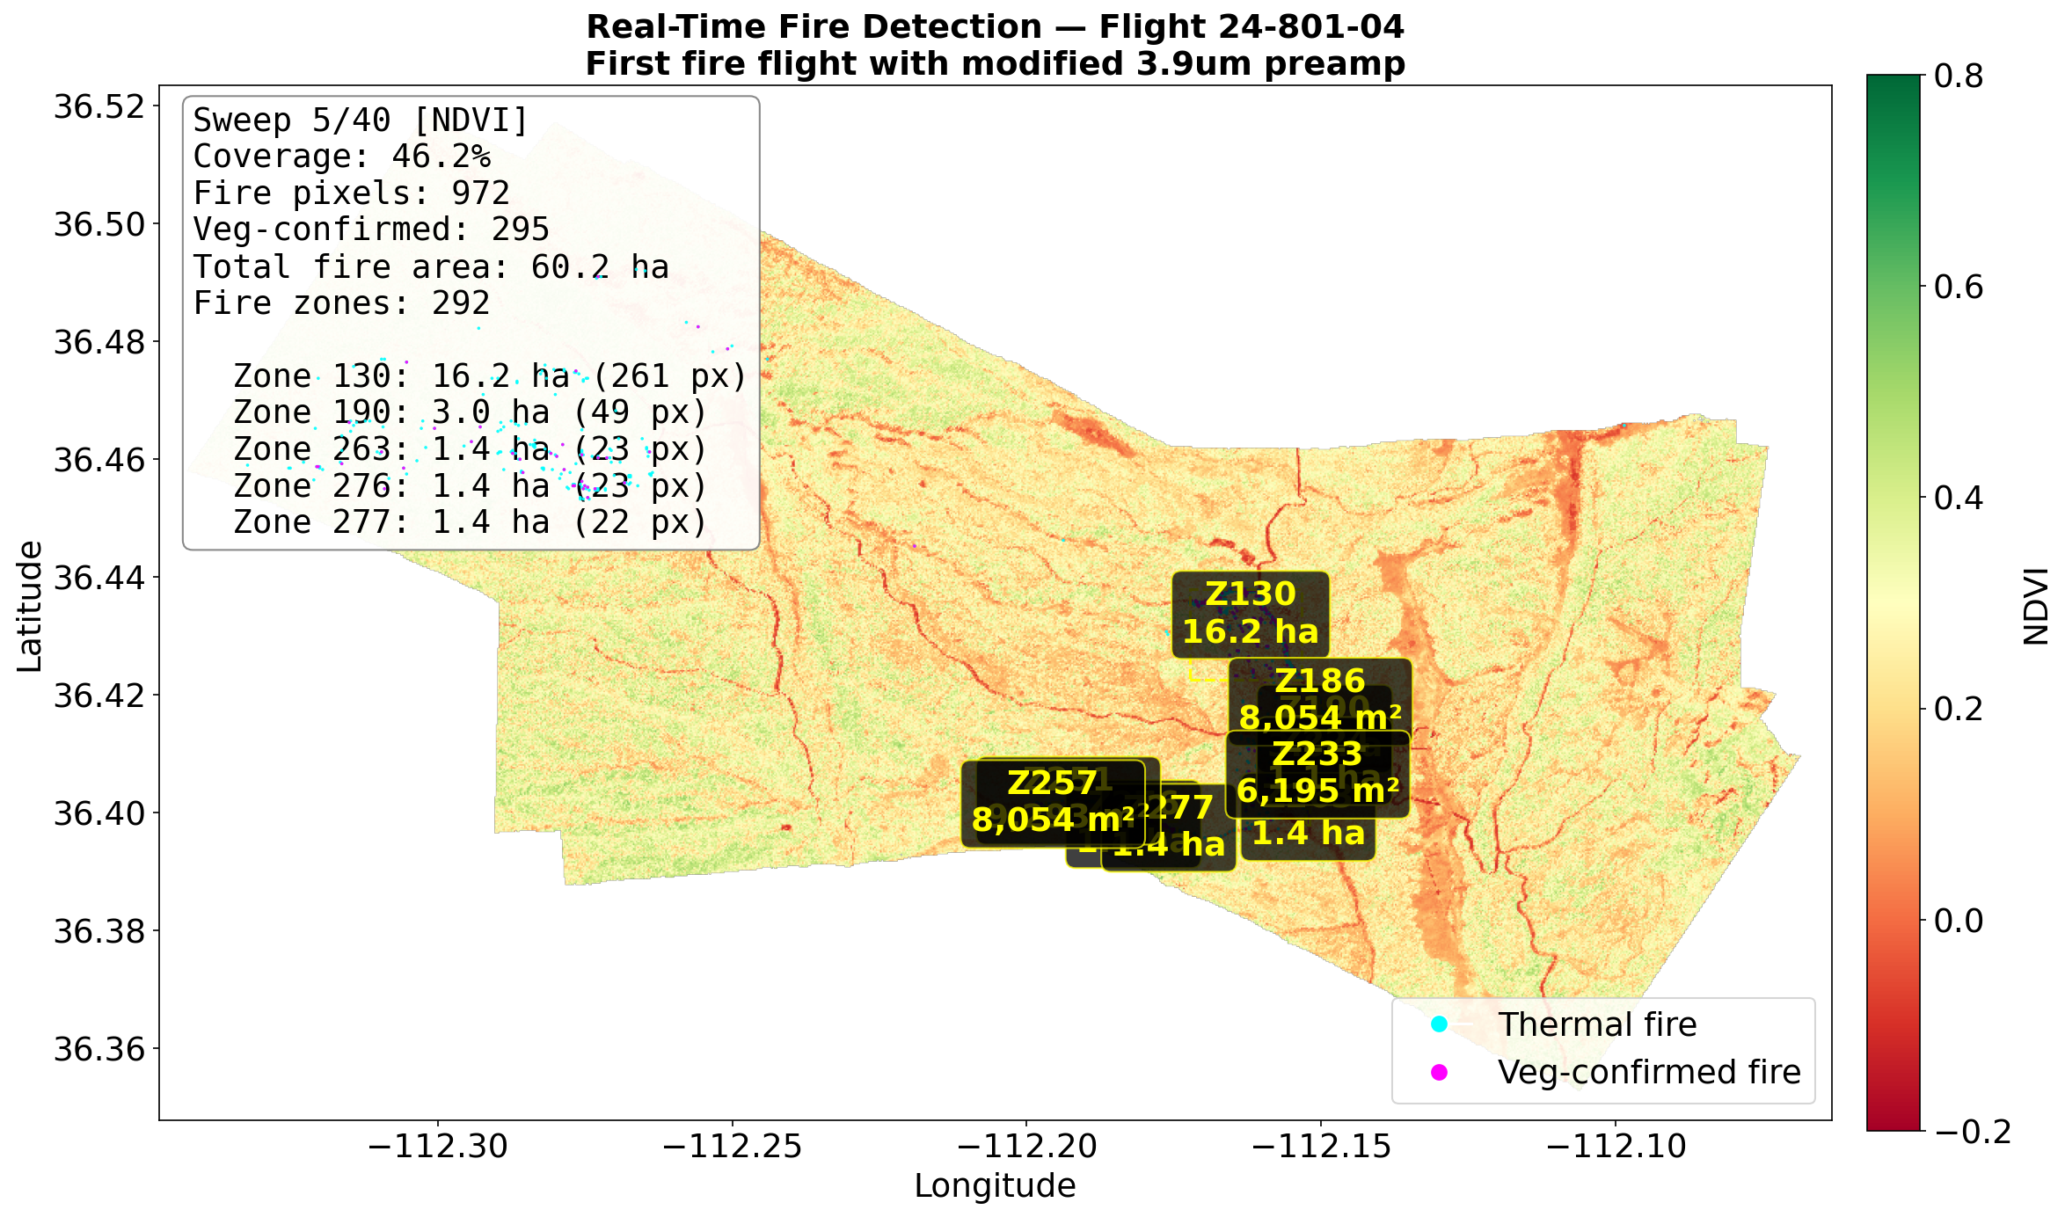
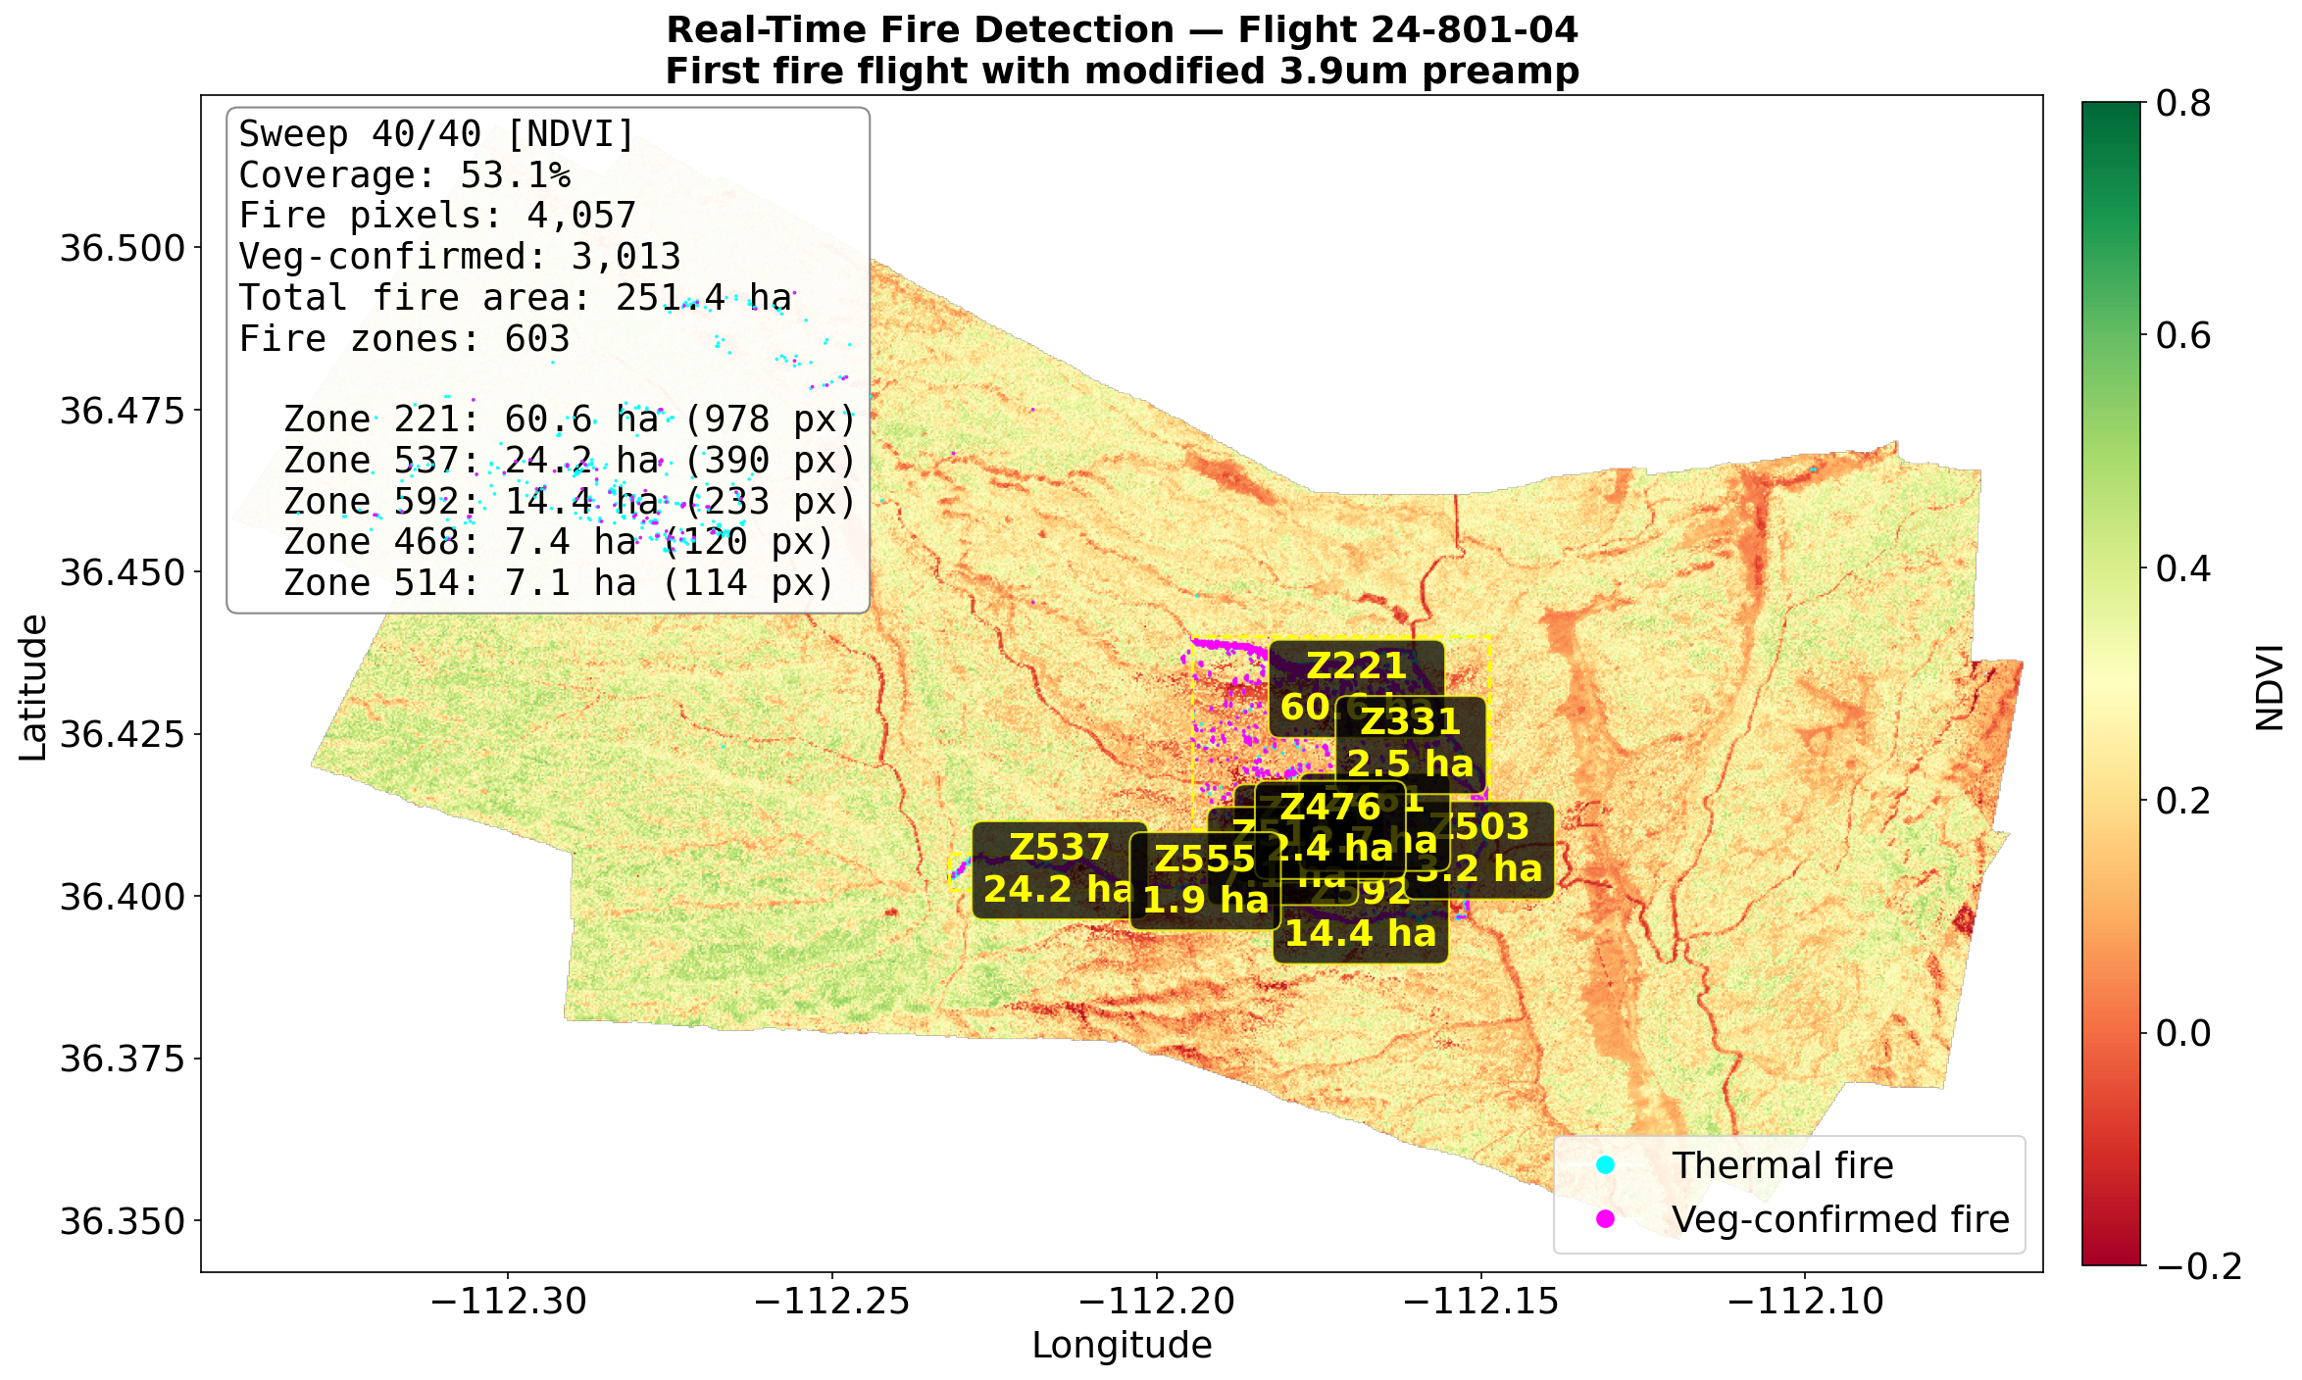
Real-Time Simulation — Active Fire (Night)
Flight 24-801-04: 40 sweeps, fire grows over time
Sweep 5/40 — Early fire detection
Sweep 40/40 — Full fire extent with zone labels
Night flight with modified 3.9μm preamp — fire zones detected and labelled in real time
GIF animation: plots/gifs/ml_2480104_active.gif

Slide 22
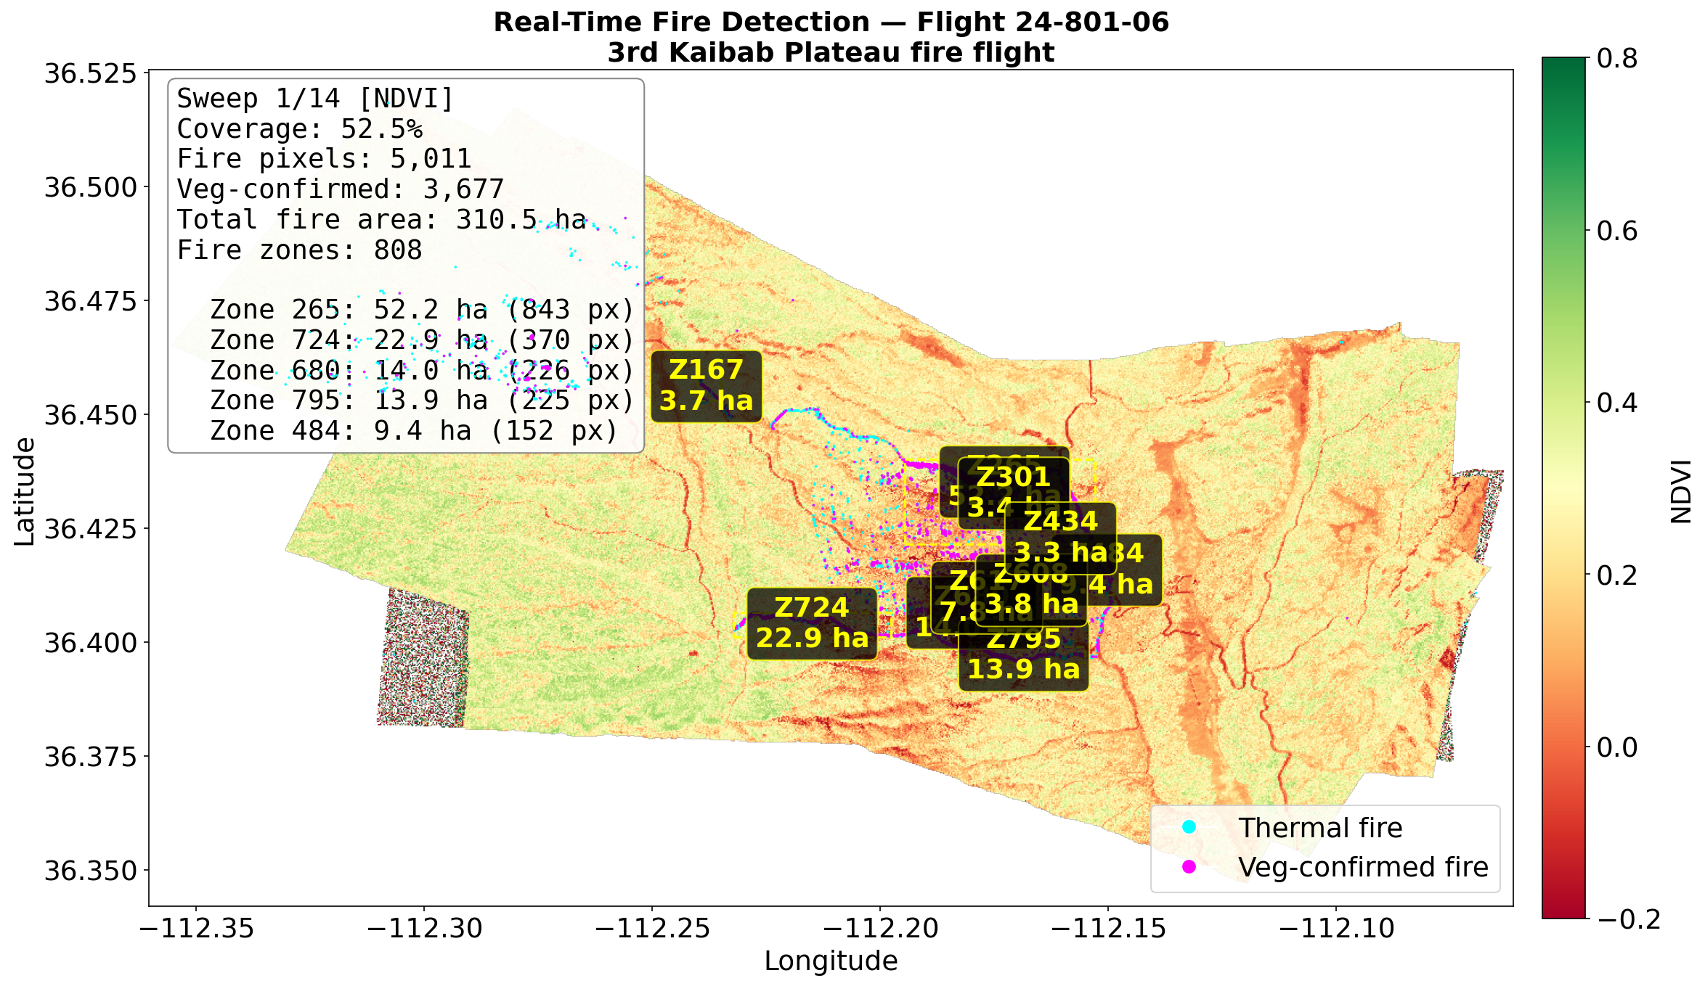
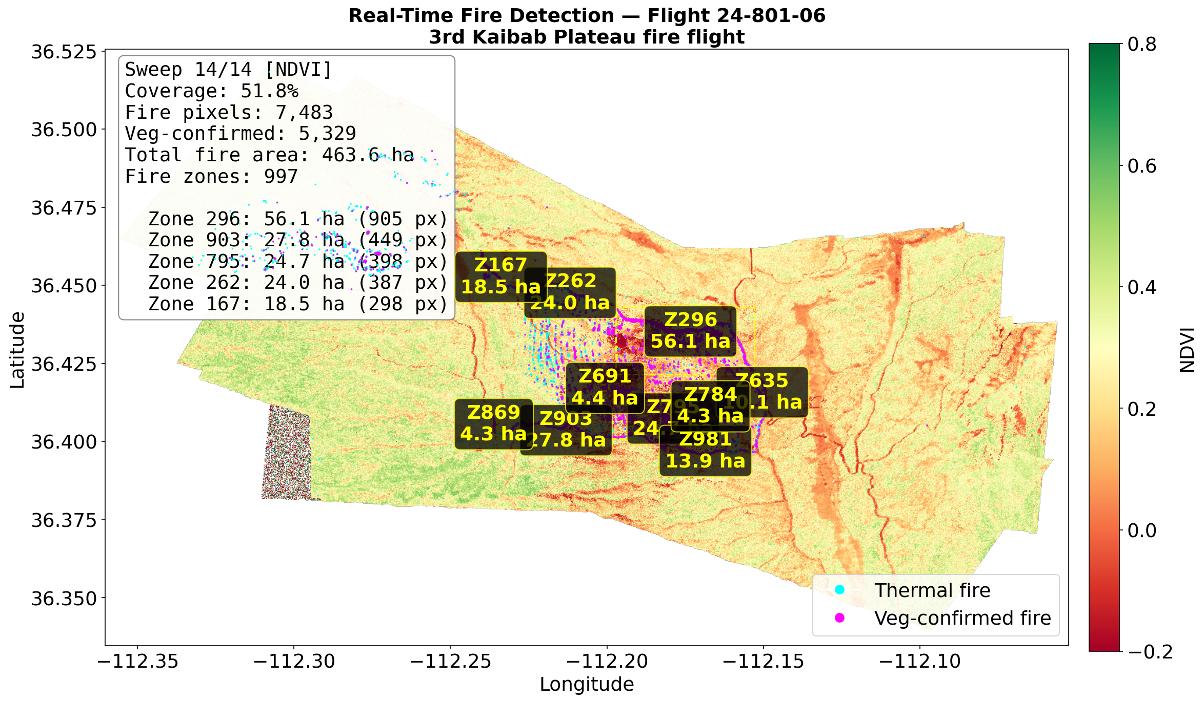
Real-Time Simulation — Daytime Smoldering
Flight 24-801-06: Vegetation-confirmed burn scars (14 sweeps)
Sweep 1/14 — Initial scan
Sweep 14/14 — 7,483 fire px, 5,329 veg-confirmed, 463 ha
Daytime smoldering with NDVI vegetation-loss confirmation (magenta markers)
GIF animation: plots/gifs/ml_2480106_smoldering.gif

Slide 23
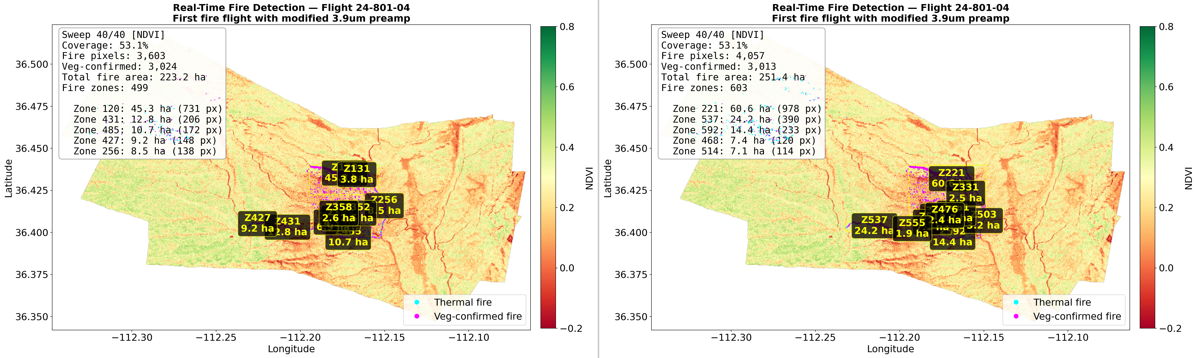
Threshold vs MLP — Active Fire (Flight 04)
Left: Simple threshold (T4>325K, dT>10K) | Right: MLP detector
Simple: 3,603 fire px (223 ha) | MLP: 4,057 fire px (251 ha)
MLP detects more fire at edges and in smoldering regions — higher sensitivity
Side-by-side GIF: plots/gifs/compare_2480104_active.gif

Slide 24
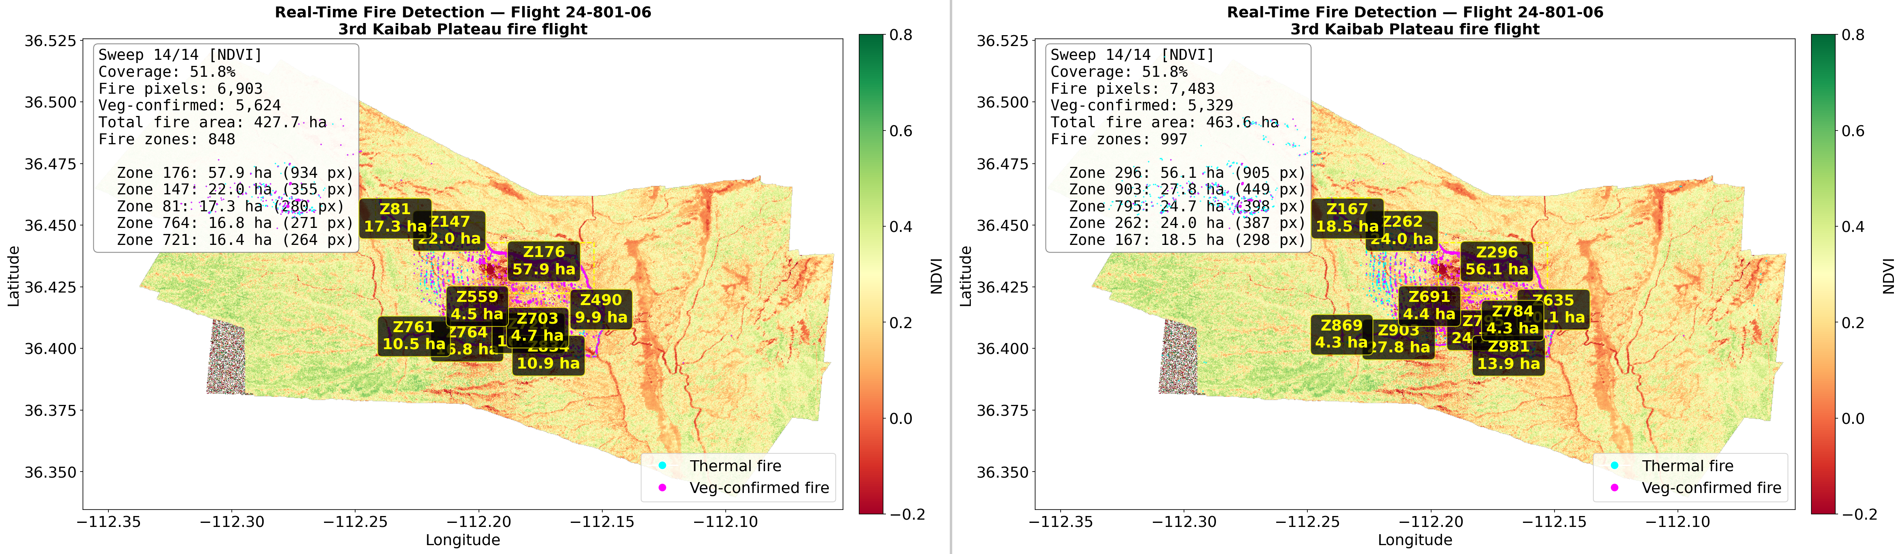
Threshold vs MLP — Smoldering (Flight 06)
Left: Simple threshold | Right: MLP detector
Simple: 6,903 fire px (428 ha) | MLP: 7,483 fire px (464 ha)
MLP captures additional smoldering pixels and low-intensity burn edges
Side-by-side GIF: plots/gifs/compare_2480106_smoldering.gif

Slide 25
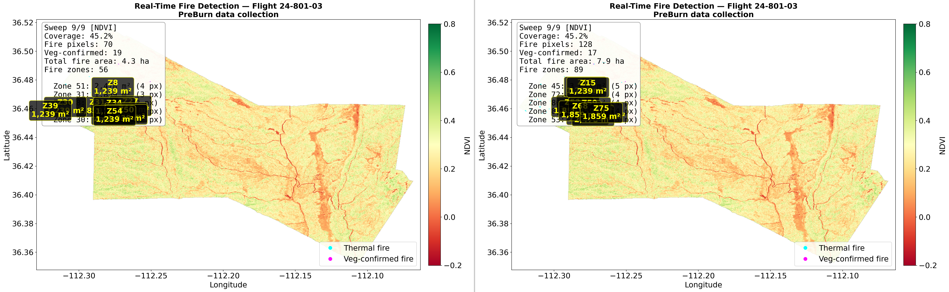
Threshold vs MLP — Pre-burn Baseline (Flight 03)
Left: Simple threshold | Right: MLP detector | No real fire present
Simple: 70 false fire px (4.3 ha) | MLP: 128 false fire px (7.9 ha)
Both detectors show some false positives on pre-burn — hot bare soil and sun glint
Multi-pass consistency filter reduces these by 52%

Slide 26
Future Work & Next Steps
Complete TabPFN grid search and compare against MLP baseline
Ensemble methods: combine MLP + TabPFN predictions
Transfer learning: apply trained models to new fire campaigns
Temporal features: leverage sequential pass information
Operational deployment: integrate with real-time mosaic pipeline
Technical Improvements
Explore deeper MLP architectures with dropout/batch norm
Investigate TabPFN with larger n_estimators
Add spatial context features (neighbor statistics)
Cross-validation across flights for robustness

Slide 27
Summary
Physics-based fire detection from 50-channel MASTER hyperspectral data
Multi-pass consistency + vegetation-loss confirmation reduce false positives
FireMLP achieves 0.031 error rate with 99.4% recall on test set
TabPFN offers meta-learned alternative with minimal hyperparameter tuning
Modular Python pipeline supports real-time simulation and batch processing
github.com | FireSense 2023 | MASTER L1B

